Slide 1
Fear and Honesty in Uncertainty
Jon Mackintosh
Managing Director
Encore SA

Slide 2
Covid: consumer demand changing?
The past six months have seen dramatic change in how we communicate and interact
Our conversations with clients are changing
Many are realising that clients see advice very differently to the products they use
Advice is much broader (and perhaps more valuable?) than products
Realising value in relationships is in understanding, not “needs”?

Slide 3
What are we learning clients value?
Agent
Adviser
Advocate
Administrator
Client Value
Distribution value
One who acts as a product reseller, short term relationship focus, low advice focus
One who provides some advice to clients but emphasises product solutions. Short Term Relationship
One who accepts their role as a client representative to product providers and who works to ensure client friendly outcomes are met. Long Term Relationship
One who realises that in order to meet long term promises a rigorous, defined and proactive long term service model is essential and builds their business and sales model on this. The business’ key product is administration and management of clients’ financial lives.

Slide 4
Covid: consumer demand changing?
Need Advice Service not just Product
Establish core relationship on ADVISER’S value – primarily on the work the adviser will be doing/has done for the client to determine an outcome
Focus on Advocacy not Agency
Win-win-win: product is a necessary adjunct to successful sale of advocate relationship.
If Adviser sits at centre of client relationship – glue has been created in the right spot – retention and growth more likely

Slide 5
Thinking change
MY BUSINESS is a KEY PRODUCT
I am responsible for MY product
Clients will stay with me based on what MY BUSINESS does for them
By presenting this consistently my view of myself and my role will change

Slide 6
Intrinsic value of an asset
The actual value of an asset based on an underlying perception of its true value including all aspects of the asset or business, in terms of both tangible and intangible factors. This value may or may not be the same as the current market value.
VALUE
ASSET
PERCEPTION

Slide 7
What is value?
Essentially there are two types of value:
Intrinsic value:
the value that an object has "in itself" or "for its own sake", as an intrinsic property
(ends)
Instrumental value:
the value of which depends on how much it generates intrinsic value
(means)

Slide 8
What is an asset?
A present economic resource controlled by the entity as a result of past events.
Where a resource is defined as:
A right, or other source of value, that is capable of producing economic benefits.
*as defined by International Accounting Standards Board

Slide 9
So what are your values?
What decisions did you make in the past that changed you or your business?
Were the impactful decisions values based or practically based?
Were values based decisions instrumental (change in specific behaviour) or intrinsic (change in end goal?)
Are you creating a perception of value (Asset) ?

Slide 10
Knowing why states your values
Why we do what we do
We believe managing money properly has more impact on people’s happiness and choices than anything else.
It will determine or remove happiness in life, family and relationships.
Misunderstanding this is the cause of enormous personal misery, pain and stress.
We exist to eliminate misunderstanding and its destructive consequences. We are life and opportunity maximisers.

Slide 11
Knowing how to be valuable
How do we do it?
Financial advice affects every aspect of a client’s life and is deeply personal. Getting it right changes everything.
We interpret professionalism as putting the client’s interest first and consciously advocate for their interests always.
We know that advice is multi year journey and we have structured a business model allowing us to meet requirements our clients did not know they had in their lives.
We serve, listen and understand.

Slide 12
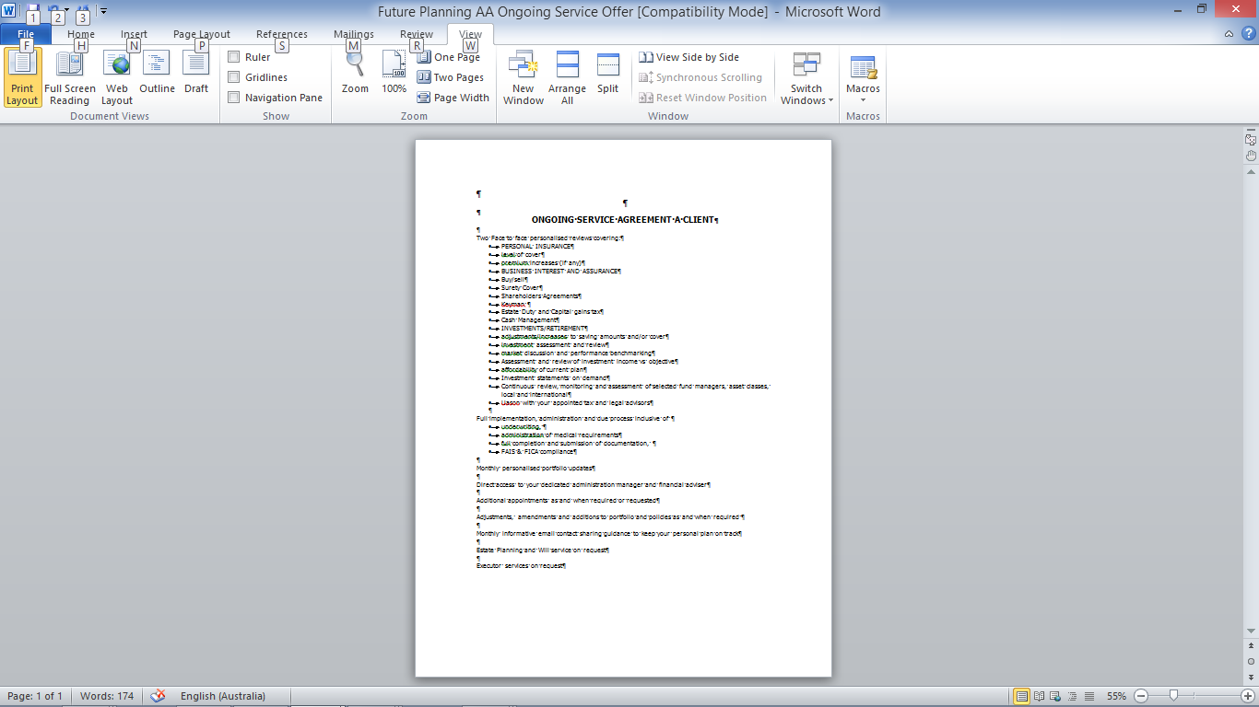
Tender based on your values
INTRODUCTION
Client sent pre-appointment package inclusive of: Confidentiality Agreement, Description of Our Process and Checklist to prepare them for our first meeting
CLIENT MEETING TWO
Formal Presentation of Financial Plan
Formal Presentation of Financial Management and Service Agreements
Discussion and clarification of any client queries or concerns
At this stage in the process the client will be asked if they wish to become a client and join our Financial Family
CLIENT MEETING ONE
Client presented with signed Confidentiality Agreement
Financial Planning Process Explained
3. Comprehensive analysis of client’s current financial situation undertaken including:
Current income and expense budget;
savings, assets, investments, loans, credit and other liabilities;
personal, and work structures and requirements; state of current estate planning;
short and long term desires and outcomes;
We will provide and manage all administrative and legal documentation necessary to best understand your current situation whilst ensuring your personal information is protected.
We will invest 20 hours of our time to ensure you have the information you need to make the right decision for you
IMPLEMENTATION AND ADMINISTRATION OF CLIENT FINANCIAL PLAN
All administrative paperwork inclusive of relevant application forms, legal documentation, wills, records of advice will be managed on the client’s behalf
We will manage all negotiations and administrative requirements pertaining to share investments, unit trust investments, insurance, retirement benefits, trusts, etc in line with our client’s instructions and best interests
We will ensure that all steps in our Financial Management and Service agreements are administered, active and managed on the client’s behalf in line with expectations
We will proactively act as your Financial Conscience through regular and meaningful management of your financial circumstances
INDIVIDUAL ANALYSIS AND PLAN PREPARATION
Exact information pertaining to a client’s current financial circumstances to be obtained on client’s behalf
Full analysis by Senior Financial Adviser to determine short and long term strategies to enhance client’s financial circumstances
Analysis documented as full Financial Plan
All administrative requirements prepared on client’s behalf
Ongoing Financial Management and Service Agreement prepared

Slide 13
My view on the purpose of a service relationship
A client doesn’t pay to purchase a policy or to give their money up to an investment company
A client is paying to outsource the management and administration of their finances
The financial Adviser’s purpose is to ensure that information shared between the client and providers is current, correct and inline with current circumstances, but much more it is to work more broadly with the client and to understand the realities of their financial circumstances beyond product based “needs”
This includes assistance with debt management, spending patterns, savings behaviour and many others.

Slide 14
Structuring ongoing service
Not all clients need or want the same service
Think efficient for your business but meaningful for client
Remember the outcome you are aiming for

Slide 15
Same destination, choice of service

Slide 16

Tender gets clients on board the plane, service offers determine class of travel
1st Class
Business Class
A
Premium Economy
B
Economy
C
D

Slide 17
Tender gets clients on board the plane, service offers determine class of travel
Price
Highly personal one on one private client service regime
Service
1st Class
Business Class
One on one private client service regime
Premium Economy
System driven process, light personal touch
Economy
System driven process, administrative and proactive

Slide 18
Exchange of value
VALUE
WHY
DESTINATION
PRICING
WHAT & HOW
CLASS OF TRAVEL
strategy
structure
method
Notes:
EXPECTATIONS
client knows what they are getting, what value you add, how you do business and how you charge.
EXPERIENCE
you deliver to the expectations, add the value and demonstrate how you are adding value.
RESULT
retention and referrals.

Slide 19
You can serve every class of passenger
Just a reminder, if any of the events below have occurred in your life you need to contact us immediately as your existing polices and/or investments may need to be reviewed
Buying/selling property for yourself or family
Change of job/Pay increase
Loss of job or income
Retirement of self or key business staff
Birth of a child or children have left home
Change of marital status
Taking on or paying off debt (eg personal loan, business loan, bond)
Death/disability of a family member
Inheritance
Change in Medical Circumstances
Redundancy
Buying/selling property or equipment for your business
Business Revenue/Profit increase or decrease
Death/disability of a business partner or key staff member
Sale of shares in your business

Slide 20
Start now! This is your chance!
Same message every month to every client
Be there, your existing base is key to your future
Serve first based on values, sell second after serving
Your value is in your knowledge and experience
It is much broader than you think
Offer clients value consistently and they will value it in return
There is a big difference between a client and a customer!

Slide 21
Be the professionals we should be
Profession means a pledge or assurance.
Promises that dangerous methods will be used only for the benefit of the served society in return for the right (ie the license) to use them
Puts the interests of a served society above their own self interests while acting in the licensed role

Slide 22
What I think you do
You administer peoples financial lives and act as their financial conscience
You are the client advocate who ensures outcomes in a complex commercial world
You do not have to SELL products, they are prescription only

Slide 23
You do have to stop GIVING advice though…
It’s simply too valuable

