Slide 1

Inseta Self Mastery
Becoming a self genius …
Tilly Govender
Professional Coach, Speaker and Trainer
Certified by John Maxwell
Mindwiz Transformation Academy
www.themindwiz.com

Slide 2
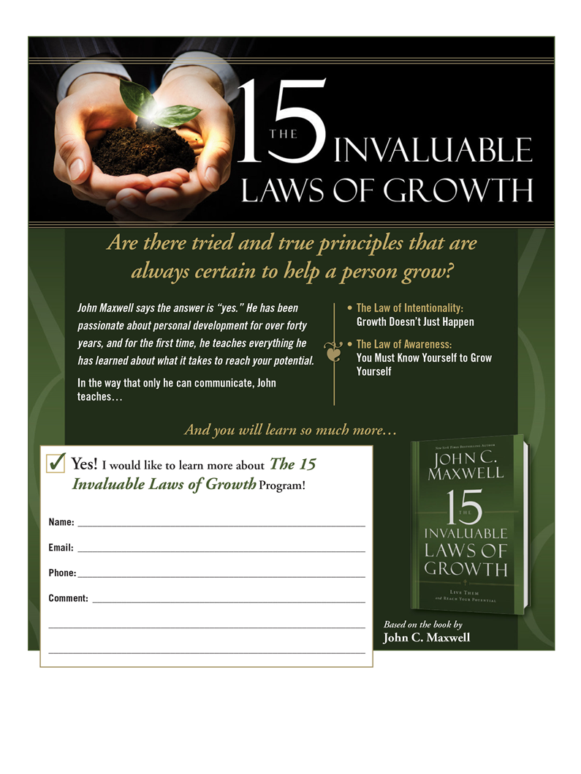
Becoming a Self Genius …affording you the best chance of becoming the person you were created to be !
Foundational
Building Block
Penthouse
Mastermind Classes https://www.themindwiz.com

Slide 3
Becoming a self genius
1. The Law Of Intentionality – Growth Doesn’t Just Happen
2.The Law Of Pain – Good Management of Bad Experiences Leads to Great Growth
3. The Law Of The Rubber Band – Growth Stops When You Lose The Tension
Between Where You Are And Where You Could Be

Slide 4
THE LAW OF INTENTIONALITY
“Growth Doesn’t Just Happen”
  Do you have a personal growth plan?
PERSONAL GROWTH IS NOT A NATURAL PROCESS IN MOST PEOPLE’S LIVES.
Does working longer and harder guarantee success?
How do you get better at what you do?
How do you improve your relationships?
How do you gain wisdom and insight?
What is the difference between goals and growth?
“ People are anxious to improve their circumstances but unwilling to improve
themselves; they therefore remain bound” – As a Man Thinketh

Slide 5
LAW OF INTENTIONALITY
Growth just doesn’t happen.
Personal Growth is not a ____________________ in most people’s lives.
Growth Gap Traps
1. The Assumption Gap – “I assume that I will _________________ grow.”
2. The Knowledge Gap – “I _________________ to grow.”
3. The Timing Gap – “It’s not the _________________ to begin.”
4. The Mistake Gap – “I am afraid of _______________________.”
5. The Perfection Gap – “I have to find the best way ______________ I start.”
6. The inspiration Gap – “I don’t __________ like doing it.”
7. The Comparison Gap – “__________ are better than I am.”
8. The Expectation Gap – “I thought it would be __________ than this.”

Slide 6
Law of Intentionality
Now ask yourself : What emotion is stronger?
The desire to change and grow,
Or one of these fears?
Fear of Failure
Fear of trading security for the unknown
Fear of being over extended on resources
Fear of what others think
Fear of pushing others away

Slide 7
Self Assessment : Transforming Mindsets
Accidental Growth Intentional Growth
0 1 2 3 4 5 6 7 8 9 10
Plans to start tomorrow ––––––––––––––––––––––––––––––––––––– Insists on starting now
Talks big ––––––––––––––––––––––––––––––––––––––––––––––––––––– Follows through
Plays it safe ––––––––––––––––––––––––––––––––––––––––––––––––––––Takes risks
Relies on talent ––––––––––––––––––––––––––––––––––––––––––––– Relies on character
Stops learning after graduation –––––––––––––––––––––––––––– Never stops learning
Send me a mail on tilly.inspired@gmail.com to receive a self assessment tool.

Slide 8
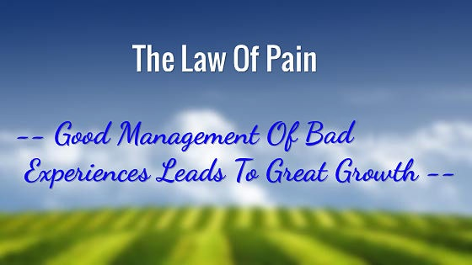
Every problem introduces a person to himself

Slide 9
The law of pain…
Truth About Bad Experiences – You need to manage them
Everyone has them
No one likes them
Few will make bad experiences positive experiences
The Pain File
The pain of Inexperience – “I have never been through that”
The pain of Incompetence – “I should have seen that coming”
The pain of Disappointment – “I wish it never happened”
The pain of Conflict – “Human encounter doesn’t always feel good”
The pain of Change – “I have never been through that”

Slide 10
Law of Pain
The Pain File
The pain of Bad Health – “I lost what I thought I would always have”
The pain of Hard Decisions – “You can’t make everyone happy”
The pain of Financial Loss – “If I could only get that back”
The pain of Relationship Losses – “Some people will go in a different direction thanI”
The pain of Not Being Number One – “I deserve to be there”
The pain of Traveling – “When I am away, I feel ….”
The pain of Responsibility – “They expect so much from me

Slide 11
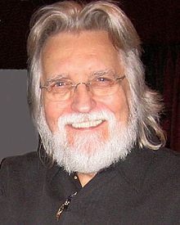
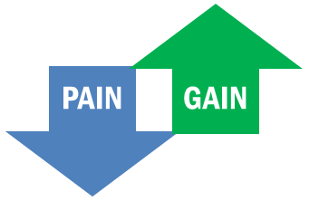
Law of Pain
Turn Your Pain Into Gain – Choice Is Yours.
“Life begins at the end
of your comfort zone”
Choose a positive life stance
Decide that life is basically good
Embrace ad develop creativity
Being creative will often show you the way
Embrace the value of bad experiences
We all face difficulties, but we do not all learn from them
Make good changes after bad experiences
Release resentment
Take responsibility for your life
Victim or victor?
The truth about being accountable and responsible for one’s life is that very few are
Neale Walsch

Slide 12
Law of Pain
Turn Your Pain Into Gain – Choice Is Yours.
Choose a positive life stance
Decide that life is basically good
Embrace and develop creativity
Being creative will often show you the way
Embrace the value of bad experiences
We all face difficulties, but we do not all learn from them
Make good changes after bad experiences
Release resentment
Take responsibility for your life
Victim or victor?
The truth about being accountable and responsible for one’s life is that very few are

Slide 13
Law of the Rubber Band
“Growth Stops When You Lose the Tension
Between Where You Are and
Where You Could Be”

Slide 14
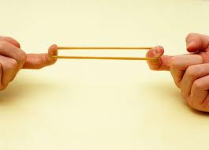
Law of the Rubberband
Growth stops when you lose the tension between where you are and where you could be …
Where you are
Where your could be

Slide 15
Law of the Rubber Band
Life is a Series of Stretches – Time to Stretch
“ God’s gift to us : potential. Our gift to God developing it!
Few People Ever Want To Be Stretched
Avoid Settling For The Status Quo
Stretching Is An “Inside” Job
Stretching Always Requires Change
Stretching Sets You Apart From Others
Stretching Can Become A Lifestyle
Stretching Gives You A Shot At Significance

Slide 16
The tragedy of being average ….
  Too many people are prepared to settle for average in life… is that bad?
  Read this description written by Edmund Gaudet, and then you decide ?
  “ Average” is the top of the bottom, the best of the worst, the bottom of the top, the worst of the best. Which of these are you?
  “Average” means being the run-of-the-mill, mediocre, insignifican, an also-ran, a nonentity.
  Being “average”is the lazy person’s cop-out: it’s lacking the guts to take a stand in life; it’s living by default.
  Being “average” is to take up space for no purpose; to take the trip through life, but never to pay the fare; to return no interest for God’s investment in you.

Slide 17
Becoming a Self Genius …affording you the best chance of becoming the person you were created to be !
Foundational
Building Block
Penthouse
Mastermind Classes https://www.themindwiz.com

Slide 18
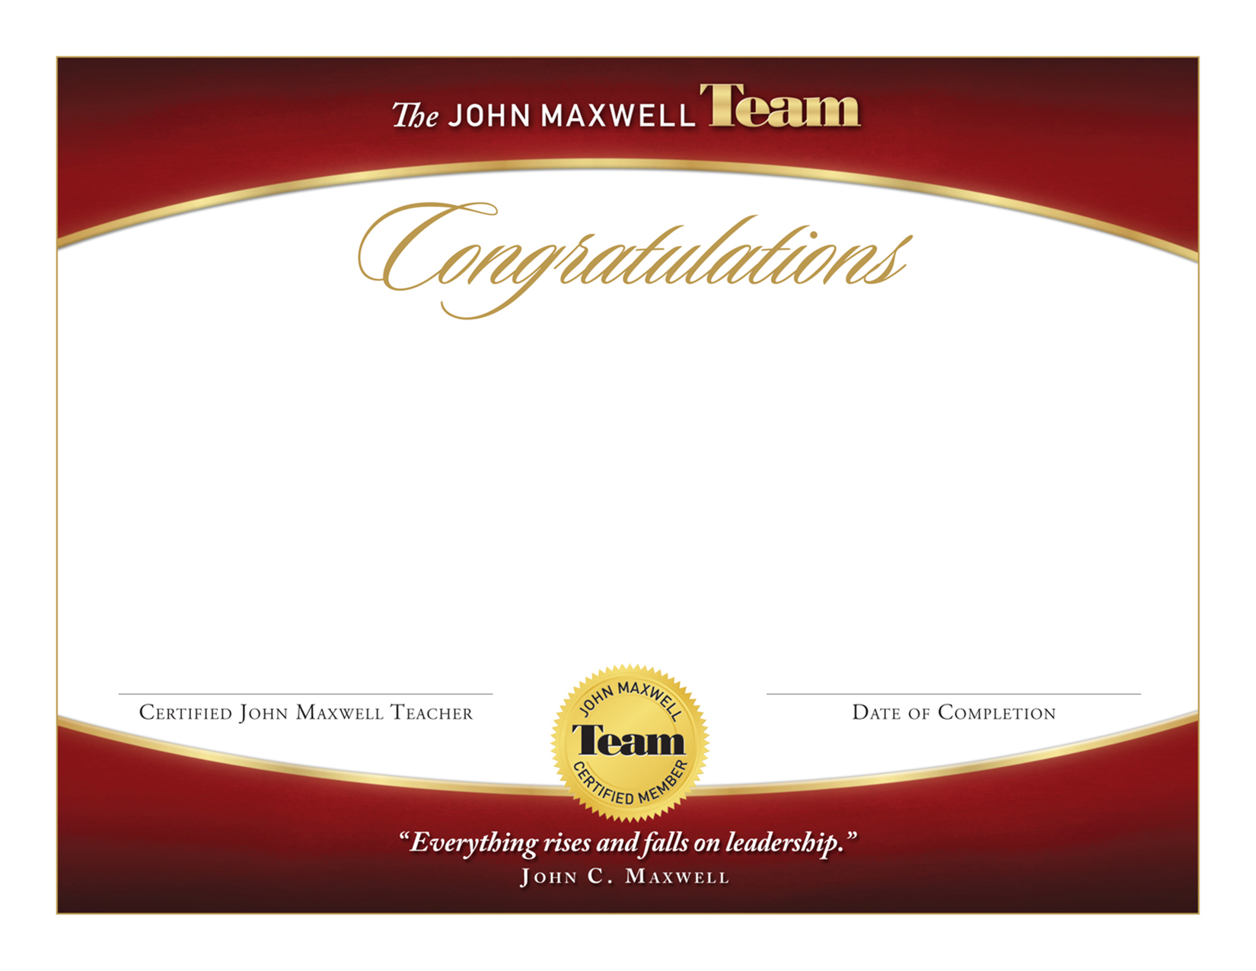
International Certification from John Maxwell

Slide 19
Becoming a Self Genius
3 MODULES
8 WEEKS
Next intake 2 September 2020
Learn, live and lead the 15 invaluable laws of growth that will transform your life!
Unlock your “E and E” factor (energy and excellence)
Unveil your true brilliance and magnificence.
World class self-transformative tools
International certification from John Maxwell
all in the safe haven and support of like-minded individuals sharing this journey with you in a mastermind class.

Slide 20
Going to be the change you want be …
Self Awareness
Character building
Skills Enhancement
Relationships
Clarity Energy Vibrancy Confidence ….
Course focuses on building the following skills:
Decisiveness – gain absolute clarity of mind and make better decisions
Collaborative Thinking – increase productivity, performance and profit
Emotional Intelligence
Adaptation
Creativity

Slide 21
Special Gift to you ….
A special gift to you …. discount
Becoming a Self Genius (value R9997) over 8 weeks
NOW R 4997 ….. First intake 3 September 2020
tilly.inspired@gmail.com
https://www.themindwiz.com
International Certification of completion from John Maxwell
Coaching services

Slide 22

Questions

Slide 23
Thank you ….
Remember you are beautiful, resourceful, you have limitless power and a reservoir of potential!
Tap into your true magnificence !
Love you all ….

