Slide 1

#Your Legacy lives on
Notes:
NB: 1. This template uses Masters that are accessable and editable under the Master view which can be accessed by going to the View tab > Under the Master Views tab choose “Slide Master”, all the slide masters will appear and can be edited there.
2. If you would like to add a slide, go to Home > New Slide > Under Office Theme all the designed slide layouts will appear and you can choose a layout that will suit your needs or that will suit the content that you would like to add onto your slide.

Slide 2
SKILLS PLANNING & RESEARCH TEAM
Skills Planning & Research ​Manager
Senior Researcher
Skills Development Specialist
Research Specialist
Skills Administrator
Skills Administrator
Skills Development Specialist

Slide 3
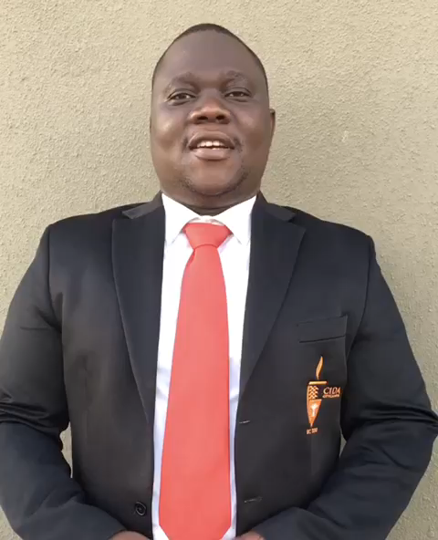



Meet the Team who are ready to support you with your submission

Slide 4
HIGH LEVEL REQUIREMENTS
Levy / Non Levy Payers REGISTERED with INSETA
Transfer into INSETA if you are with another SETA
Skills Development Facilitator REGISTRATION online
  Internal / External SDF ( Re- Register annually)
  Code of Conduct
WSP DEADLINE DATE: 31 MAY 2020 midnight
  www.inseta.org.za – CORE BUSINESS – SKILLS
  Retrieve WSP Manuals, Scarce Skills list, OFO list
Compliance requirements to submit a WSP
  All of the above and; Copy of FSCA License, or a Letter confirming your CORE business – found under the web address above
  Signed Authorisation page, WSP signed by all delegated officals as stipulated on the form
  And submitted ONLINE ONLY
NO WSP NO FUNDING

Slide 5
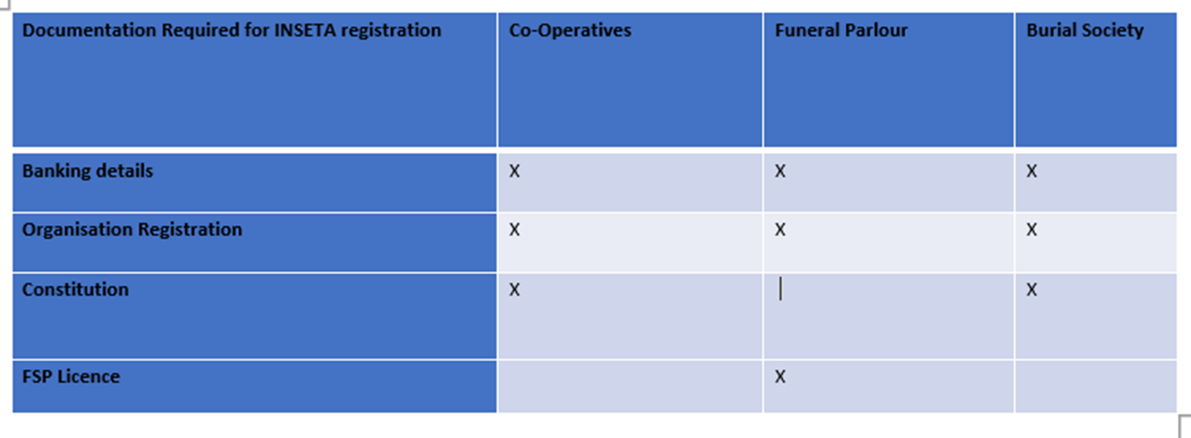
SKILLS DIVISION

Slide 6
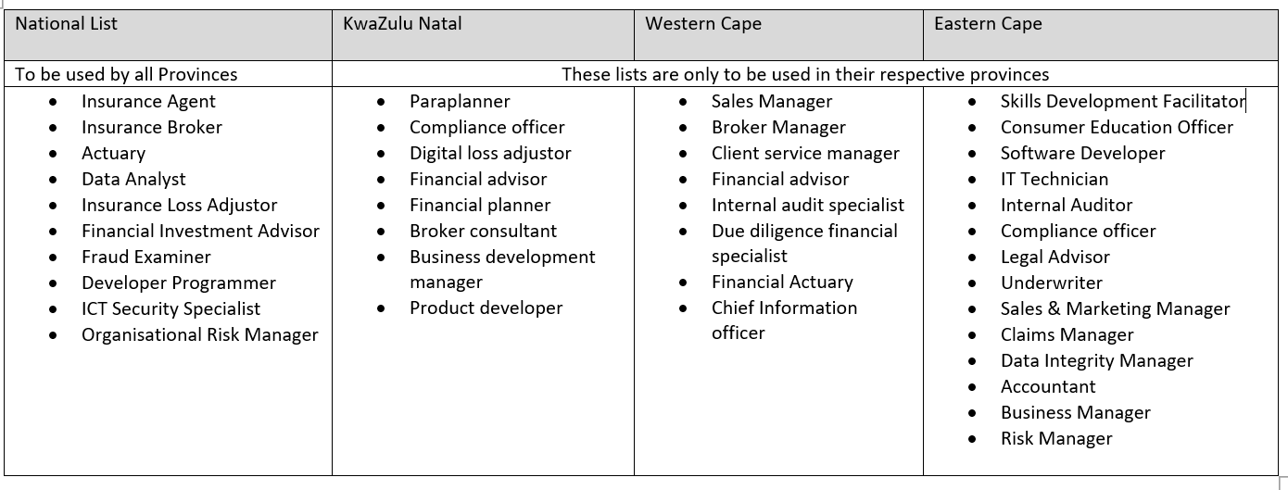
SCARCE AND CRITICAL OCCUPATIONS LIST

Slide 7
Team details
Name | Email | Telephone (Direct Line)
Adeline Singh | adelines@inseta.org.za | 0113818920
Ernest Kaplan | Ernestk@inseta.org.za | 0113818924
Bonginkosi Malinga | malingab@inseta.org.za | 0113818936
Tasmin Davids | tasmind@inseta.org.za | 0113818906
Aubrey Manganyi | Aubreym@inseta.org.za | 0113818964

Slide 8
END OF THE PRESENTATION

